Slide 1
Hotel management system
Group members:
Aleeza Akhter
Kainat Jahangir
Syeda Fatima rehman

Slide 2
Table of content
Introduction
ER Model
Contributions
Queries

Slide 3
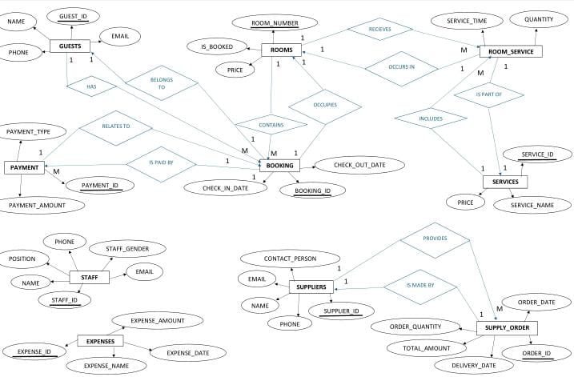
ER MODEL

Slide 4
Introduction to hotel management system
A hotel management system automates hotel operations like reservations, guest info, billing, and admin tasks. It manages reservations, rooms, guest profiles, billing, front desk operations, housekeeping, reporting, and security. It boosts efficiency, guest satisfaction, and revenue by streamlining processes and providing insights.

Slide 5
Objectives:
Organization: To maintain well-organized data regarding reservations, guests, rooms, services, and administrative tasks.
Efficiency: To streamline hotel operations, automate processes, and reduce manual effort involved in managing reservations, guest services, and administrative tasks.
Accessibility: To ensure that important information such as guest preferences, room availability, and financial data is easily accessible to authorized staff members.
Decision Support: To provide detailed reports and insights into hotel performance, occupancy rates, revenue generation, and guest satisfaction to facilitate informed decision-making by management.
Scalability: To accommodate the growth of the hotel business by handling increased data volume, expanding services, and adapting to changing business needs seamlessly.

Slide 6
contribution
Kainat:
Created tables, inserted data in tables and wrote 10 queries.
Fatima:
Made ER Model, helped in making tables and wrote 10 queries.
Aleeza:
Wrote 30 queries.

Slide 7



QUERIES
Queries of Table : 1(GUESTS)
SELECT * FROM Guests;
SELECT COUNT(*) AS total_guests FROM Guests;
SELECT name, email FROM Guests WHERE phone LIKE '123%';

Slide 8
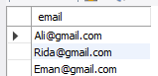

SELECT DISTINCT email FROM Guests;
SELECT name, email FROM Guests WHERE guest_id IN (SELECT guest_id FROM Bookings);

Slide 9


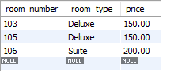
Queries of Table:2(ROOMS)
SELECT * FROM Rooms;
SELECT COUNT(*) AS booked_rooms FROM Rooms WHERE is_booked = TRUE;
SELECT room_number, room_type, price FROM Rooms WHERE price > 100;

Slide 10


SELECT DISTINCT room_type FROM Rooms;
Select room_number,room_type FROM Rooms Where is_booked=FALSE;

Slide 11



Queries of Table:3(BOOKINGS)
SELECT * FROM Bookings;
SELECT guest_id, COUNT(*) AS booking_count FROM Bookings GROUP BY guest_id;
SELECT * FROM Bookings WHERE check_out_date BETWEEN CURDATE() AND DATE_ADD(CURDATE(), INTERVAL 7 DAY);

Slide 12


SELECT * FROM Bookings WHERE DATEDIFF(check_out_date, check_in_date) > 3;
SELECT b.booking_id, g.name, r.room_number, r.room_type
FROM Bookings b
JOIN Guests g ON b.guest_id = g.guest_id
JOIN Rooms r ON b.room_number = r.room_number;

Slide 13



Queries of Table:4(STAFF)
SELECT * FROM Staff;
SELECT staff_gender, COUNT(*) AS total FROM Staff GROUP BY staff_gender HAVING COUNT(*) > 0;
SELECT name, position FROM Staff WHERE position = 'Manager';

Slide 14


SELECT DISTINCT position FROM Staff;
SELECT name, email FROM Staff WHERE email LIKE '%@gmail.com';

Slide 15



Queries of Table:5(SERVICES)
SELECT * FROM Services;
SELECT COUNT(*) AS total_services FROM Services;
SELECT service_name, price FROM Services WHERE price > 50;

Slide 16


SELECT DISTINCT service_name FROM Services;
SELECT service_name FROM Services WHERE service_id IN (SELECT service_id FROM Room_Service);

Slide 17



Queries of Table:6(ROOM_SERVICES)
SELECT * FROM Room_Service;
SELECT room_number, COUNT(*) AS service_count FROM Room_Service GROUP BY room_number;
SELECT * FROM Room_Service WHERE service_time > '10:00:00';

Slide 18


SELECT DISTINCT room_number FROM Room_Service;
SELECT rs.room_number, s.service_name, rs.quantity, rs.service_time FROM Room_Service rsJOIN Services s ON rs.service_id = s.service_id;

Slide 19



Queries of Table:7(PAYMENTS)
SELECT * FROM Payments;
SELECT payment_type, COUNT(*) AS payment_count FROM Payments GROUP BY payment_type;
SELECT * FROM Payments WHERE amount > 200;

Slide 20


SELECT DISTINCT payment_type FROM Payments;
SELECT p.payment_id, b.guest_id, b.room_number, p.amount, p.payment_type FROM Payments p JOIN Bookings b ON p.booking_id = b.booking_id;

Slide 21



Queries of Table:8(EXPENSES)
SELECT * FROM Expenses;
SELECT COUNT(*) AS total_expenses FROM Expenses;
SELECT * FROM Expenses WHERE amount > 100;

Slide 22

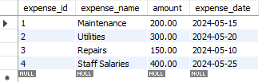
SELECT DISTINCT expense_name FROM Expenses;
SELECT * FROM Expenses WHERE expense_date BETWEEN DATE_SUB(CURDATE(), INTERVAL 1 MONTH) AND CURDATE();

Slide 23



Queries of Table:9(SUPPLIERS)
SELECT * FROM Suppliers;
SELECT COUNT(*) AS total_suppliers FROM Suppliers;
SELECT * FROM Suppliers WHERE contact_person LIKE 'A%';

Slide 24


SELECT DISTINCT name FROM Suppliers;
SELECT name, contact_person FROM Suppliers WHERE supplier_id IN (SELECT supplier_id FROM Supply_Orders);

Slide 25
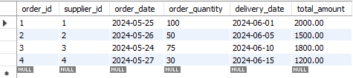

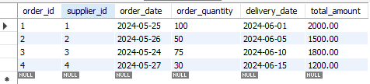
Queries of Table:10(SUPPLY_ORDERS)
SELECT * FROM Supply_Orders;
SELECT supplier_id, COUNT(*) AS order_count FROM Supply_Orders GROUP BY supplier_id;
SELECT * FROM Supply_Orders WHERE total_amount > 500;

Slide 26
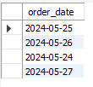
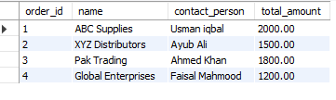
SELECT DISTINCT order_date FROM Supply_Orders;
SELECT so.order_id, s.name, s.contact_person, so.total_amount FROM Supply_Orders soJOIN Suppliers s ON so.supplier_id = s.supplier_id;

